Slide 1
Interdomain Routing
(Adapted from Nick Feamster and Bruce Maggs)

Slide 2
Today’s Lecture: Interdomain Routing
Today’s interdomain routing protocol: BGP
  BGP route attributes
    Usage
    Problems
  Business relationships
Today’s Paper: Stable Internet Routing without Global Coordination
  Main ideas
  Extensions
See http://nms.lcs.mit.edu/~feamster/papers/dissertation.pdf
(Chapter 2.1-2.3) for good coverage of today’s topics.

Slide 3

Internet Routing
Abilene
Georgia
Tech
Comcast
The Internet
AT&T
Cogent
Large-scale: Thousands of autonomous networks
Self-interest: Independent economic and performance objectives
But, must cooperate for global connectivity

Slide 4

Internet Routing Protocol: BGP
Autonomous Systems (ASes)
Route Advertisement
Destination Next-hop AS Path
130.207.0.0/16
Traffic
192.5.89.89
10578..2637
130.207.0.0/16
66.250.252.44
174… 2637
Session
Notes:
Diagram of routing table is very confusing because it’s not pointing to anything
Green arrow shorter, and too thick… green is a msg
More intuition about how the system actually works.
Don’t say “interdomain”
DESTINATION-BASED Routing
Tables look like a set of possible routes and a rankings over these routes
(pop up a simplified table fragment)

Slide 5
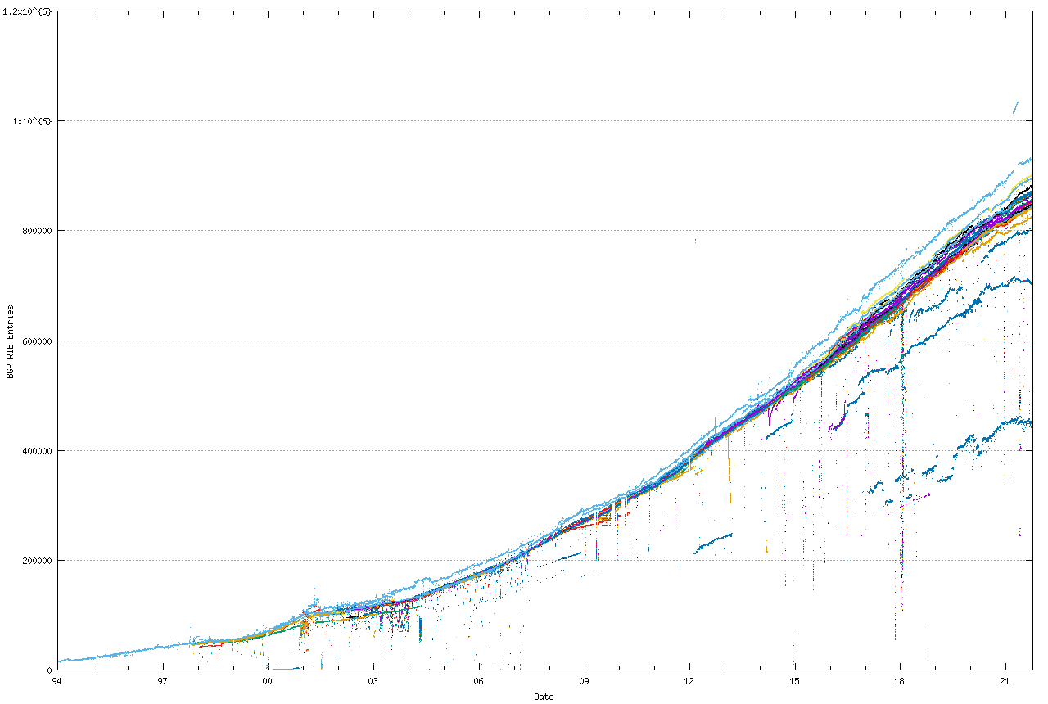
Explosive Routing Prefixes
Report Date: 22 Sep 2021 14:23 UTC+1000

Slide 6
Two Flavors of BGP
iBGP
eBGP
External BGP (eBGP): exchanging routes between ASes
Internal BGP (iBGP): disseminating routes to external destinations among the routers within an AS
Question: What’s the difference between IGP and iBGP?

Slide 7
Internal BGP (iBGP)
“iBGP”
Default: “Full mesh” iBGP.
Doesn’t scale.
Large ASes use “Route reflection”
Route reflector:
non-client routes over client sessions;
client routes over all sessions
Client: don’t re-advertise iBGP routes.
Notes:
Put “RR” and “C” in the bubbles to make clear what’s a route reflector
What problem arises?
If the client receives something from a route reflector, it doesn’t re-advertise it

Slide 8
Example BGP Routing Table
The full routing table
> show ip bgp
Network Next Hop Metric LocPrf Weight Path
*>i3.0.0.0 4.79.2.1 0 110 0 3356 701 703 80 i
*>i4.0.0.0 4.79.2.1 0 110 0 3356 i
*>i4.21.254.0/23 208.30.223.5 49 110 0 1239 1299 10355 10355 i
* i4.23.84.0/22 208.30.223.5 112 110 0 1239 6461 20171 i
Specific entry. Can do longest prefix lookup:
> show ip bgp 130.207.7.237
BGP routing table entry for 130.207.0.0/16
Paths: (1 available, best #1, table Default-IP-Routing-Table)
Not advertised to any peer
10578 11537 10490 2637
192.5.89.89 from 18.168.0.27 (66.250.252.45)
Origin IGP, metric 0, localpref 150, valid, internal, best
Community: 10578:700 11537:950
Last update: Sat Jan 14 04:45:09 2006
Prefix
AS path
Next-hop

Slide 9
Routing Attributes and Route Selection
BGP routes have the following attributes, on which the route selection process is based:
Local preference: numerical value assigned by routing policy. Higher values are more preferred.
AS path length: number of AS-level hops in the path
Multiple exit discriminator (“MED”): allows one AS to specify that one exit point is more preferred than another. Lower values are more preferred.
Shortest IGP path cost to next hop: implements “hot potato” routing
Router ID tiebreak: arbitrary tiebreak, since only a single “best” route can be selected

Slide 10
BGP Tie breaking
Tier-1 Provider A
Tier-1 Provider B
BGP specification [RFC 4271]
  Local preference
  AS_PATH
  Origin of prefix
  MED
  Type of BGP session
  Interior cost
  Router id
  Neighbor address
Cisco & Juniper Implementation
  Local preference
  AS_PATH
  Origin of prefix
  MED
  Type of BGP session
  Interior cost
  Arrival time
  Router id
  Neighbor address
Xiao et al. AnyOpt: predicting and optimizing IP Anycast performance SIGCOMM 2021
Notes:
Despite our proofs, we found that a client may not have a linear preference order under the scenarios stated in the previous slide.
after careful investigation, we found that typically this was caused by a BGP implementation issue
The left side list several factors in sequence described in the BGP RFC spec, Those factors are used in the tie breaking on the BGP router
Different from the RFC spec, the real implementation of the major network device manufactures usually have one more factor between interior cost and router id, and that is the route’s arrival time
CL
In order to account for the arrival order, in each pairwise comparison, we announce the prefix from the two sites in two different orders

Slide 11
Other BGP Attributes
Next-hop: 192.5.89.89
iBGP
Next-hop: 4.79.2.1
4.79.2.2
4.79.2.1
Next-hop: IP address to send packets en route to destination. (Question: How to ensure that the next-hop IP address is reachable?)
Community value: Semantically meaningless. Used for passing around “signals” and labelling routes. More in a bit.

Slide 12
Local Preference
Higher local pref
Primary
Destination
Backup
Lower local pref
Control over outbound traffic
Not transitive across ASes
Coarse hammer to implement route preference
Useful for preferring routes from one AS over another (e.g., primary-backup semantics)

Slide 13
Communities and Local Preference
Primary
Destination
Backup
“Backup” Community
Customer expresses provider that a link is a backup
Affords some control over inbound traffic

Slide 14
AS Path Length
Traffic
Destination
Among routes with highest local preference, select route with shortest AS path length
Shortest AS path != shortest path, for any interpretation of “shortest path”

Slide 15
AS Path Length Hack: Prepending
AS 4
AS Path: “2 1”
AS Path: “3 1 1”
Traffic
AS 2
AS 3
AS Path: “1”
AS Path: “1 1”
AS 1
D
Attempt to control inbound traffic
Make AS path length look artificially longer
How well does this work in practice vs. e.g., hacks on longest-prefix match?

Slide 16
Multiple Exit Discriminator (MED)
Dest.
San Francisco
New York
MED: 20
Traffic
MED: 10
I
Los Angeles
Mechanism for AS to control how traffic enters, given multiple possible entry points.

Slide 17
Hot-Potato Routing
Prefer route with shorter IGP path cost to next-hop
Idea: traffic leaves AS as quickly as possible
Dest.
New York
Atlanta
Traffic
Common practice: Set IGP weights in accordance with propagation delay (e.g., miles, etc.)
5
10
I
Washington, DC

Slide 18
Problems with Hot-Potato Routing
Small changes in IGP weights can cause large traffic shifts
Dest.
New York
Atlanta
Traffic
Question: Cost of sub-optimal exit vs. cost of large traffic shifts
11
5
10
I
Washington, DC

Slide 19
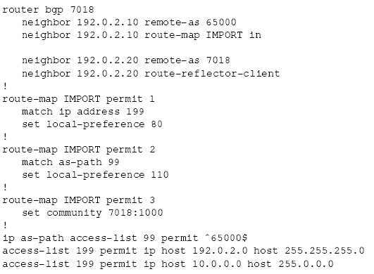
What policy looks like in Cisco IOS
eBGP Session
Inbound “Route Map”
(import policy)

Slide 20
General Problems with BGP
Convergence
Security
  Too easy to “steal” IP address space
    http://www.renesys.com/blog/2006/01/coned_steals_the_net.shtml
    Regular examples of suspicious activity (see Internet Alert Registry)
  Hard to check veracity of information (e.g., AS path)
  Can’t tell where data traffic is actually going to go
Broken business models
  “Depeering” and degraded connectivity: universal connectivity depends on cooperation. No guarantees!
Policy interactions
  Oscillations (e.g., today’s paper)

Slide 21
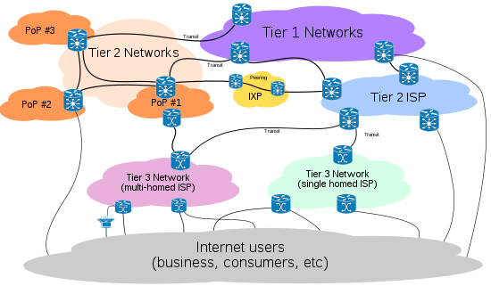
Different Providers

Slide 22
Internet Business Model (Simplified)
Preferences implemented with local preference manipulation
Provider
Pay to use
Free to use
Peer
Get paid to use
Destination
Customer
Customer/Provider: One AS pays another for reachability to some set of destinations
“Settlement-free” Peering: Bartering. Two ASes exchange routes with one another.

Slide 23
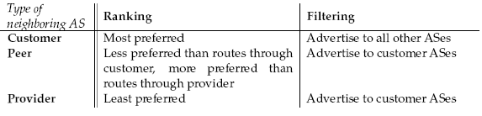
Filtering and Rankings
Filtering: route advertisement
Ranking: route selection
Customer
Primary
Competitor
Backup
Notes:
External filtering vs. internal dissemination
(external vs. internal)
What makes distributed configuration hard?
Filtering: Who gets what
Dissemination: how they get it (the path by which they get it)
Ranking: what they get
Not much else in terms of complicated side effects –
Verifying distributed program’s correctness

Slide 24
The Business Game and Depeering
Cooperative competition (brinksmanship)
Much more desirable to have your peer’s customers
  Much nicer to get paid for transit
Peering “tiffs” are relatively common
31 Jul 2005: Level 3 Notifies Cogent of intent to disconnect.
16 Aug 2005: Cogent begins massive sales effort and
mentions a 15 Sept. expected depeering date.
31 Aug 2005: Level 3 Notifies Cogent again of intent to
disconnect (according to Level 3)
5 Oct 2005 9:50 UTC: Level 3 disconnects Cogent. Mass
hysteria ensues up to, and including policymakers in
Washington, D.C.
7 Oct 2005: Level 3 reconnects Cogent
During the “outage”, Level 3 and Cogent’s singly homed customers could not reach each other. (~ 4% of the Internet’s prefixes were isolated from each other)

Slide 25
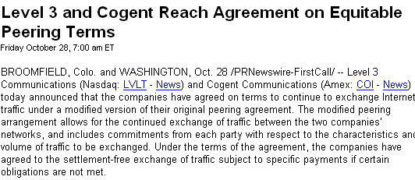
Depeering Continued
Resolution…
…but not before an attempt to steal customers!
As of 5:30 am EDT, October 5th, Level(3) terminated peering with
Cogent without cause (as permitted under its peering agreement with
Cogent) even though both Cogent and Level(3) remained in full
compliance with the previously existing interconnection agreement.
Cogent has left the peering circuits open in the hope that Level(3)
will change its mind and allow traffic to be exchanged between our
networks. We are extending a special offering to single homed Level 3 customers.
Cogent will offer any Level 3 customer, who is single homed to the
Level 3 network on the date of this notice, one year of full Internet
transit free of charge at the same bandwidth currently being supplied
by Level 3. Cogent will provide this connectivity in over 1,000
locations throughout North America and Europe.

Slide 26
General Problems with BGP
Security (more in later lecture)
  Too easy to “steal” IP address space
    http://www.renesys.com/blog/2006/01/coned_steals_the_net.shtml
  Hard to check veracity of information (e.g., AS path)
  Can’t tell where data traffic is actually going to go
Broken business models
  “Depeering” and degraded connectivity: universal connectivity depends on cooperation. No guarantees!
Policy interactions
  Oscillations (e.g., today’s paper)

Slide 27
Policy Interactions
1 3 0
1 0
1
0
2 1 0
2 0
3 2 0
3 0
2
3
Varadhan, Govindan, & Estrin, “Persistent Route Oscillations in Interdomain Routing”, 1996
Notes:
Jargon!! Remind us about filtering, ranking, and the high-level intuitive description of the property
Start off describing what AS 1 does
Put on varadhan et al.

Slide 28
Strawman: Global Policy Check
Require each AS to publish its policies
Detect and resolve conflicts
Problems:
ASes typically unwilling to reveal policies
Checking for convergence is NP-complete
Failures may still cause oscillations

Slide 29
Think Globally, Act Locally
Key features of a good solution
  Safety: guaranteed convergence
  Expressiveness: allow diverse policies for each AS
  Autonomy: do not require revelation/coordination
  Backwards-compatibility: no changes to BGP
Local restrictions on configuration semantics
  Ranking
  Filtering

Slide 30
Main Idea of Today’s Paper
Permit only two business arrangements
  Customer-provider
  Peering
Constrain both filtering and ranking based on these arrangements to guarantee safety
Surprising result: these arrangements correspond to today’s (common) behavior
Gao & Rexford, “Stable Internet Routing without Global Coordination”, IEEE/ACM ToN, 2001

Slide 31
Relationship #1: Customer-Provider
Filtering
  Routes from customer: to everyone
  Routes from provider: only to customers
From other destinations
To the customer
From the customer
To other destinations
providers
providers
advertisements
traffic
customer
customer

Slide 32
Relationship #2: Peering
Filtering
  Routes from peer: only to customers
  No routes from other peers or providers
advertisements
peer
peer
traffic
customer
customer

Slide 33
Rankings
Routes from customers over routes from peers
Routes from peers over routes from providers
provider
peer
customer

Slide 34
Additional Assumption: Hierarchy
Disallowed!

Slide 35
Securing BGP
Bruce Maggs

Slide 36
Problems with BGP
Not secure – susceptible to route “hijacking”
Routing policy determined primarily by economics, not performance
Slow to converge (and not guaranteed)
During convergence, endpoints can be disconnected even when valid routes exist

Slide 37
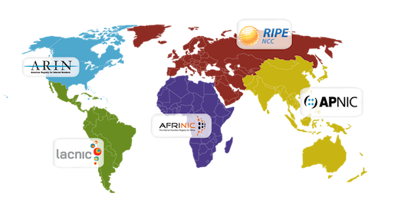
Who owns a prefix?
Organizations are granted prefixes of addresses, e.g., 128.2/16, by regional Internet registries ARIN, RIPE NCC, APNIC, AFRINIC, LACNIC
Source: http://www.apnic.net/about-APNIC/organization/history-of-apnic/history-of-the-regional-internet-registries
Organizations also separately register AS numbers, but (originally) no linkage between AS numbers and prefixes.

Slide 38
Route Hijacking
Any network can advertise that it knows a path to any prefix!
No way to check if the path is legitimate.
Highly specific advertisements (e.g., 128.2.205/24) will attract traffic.
To mitigate risk, network operators manually create filters to limit what sorts of advertisements they will trust from their peers.

Slide 39
Why Hijack Routes?
Steal some IP addresses temporarily, send SPAM until the addresses are blacklisted.
Create a sinkhole to divert traffic away from a Web site, making it unavailable.
Eavesdrop on traffic but ultimately pass it along.

Slide 40
The AS 7007 Incident
On April 25, 1997, AS 7007 (MAI Network Services) leaked its entire routing table to AS 1790 Sprint with all prefixes broken down (probably due to a bug) to /24 with original AS paths stripped off.
After MAI turned off their router, Sprint kept advertising the routes!
See http://www.merit.edu/mail.archives/nanog/1997-04/msg00444.html

Slide 41
Pakistan Telecom v. YouTube
Pakistan’s government ordered YouTube blocked to prevent viewing a video showing cartoons about Muhammad
February 24, 2008, Pakistan’s state-owned ISP advertised YouTube’s address space 208.65.153.0/24
Route prefix was more specific than the genuine announcement 208.65.153.0/22
Upstream provider PCCW Global (AS3491) forwarded announcement to rest of Internet
Requests for YouTube world wide hijacked!

Slide 42
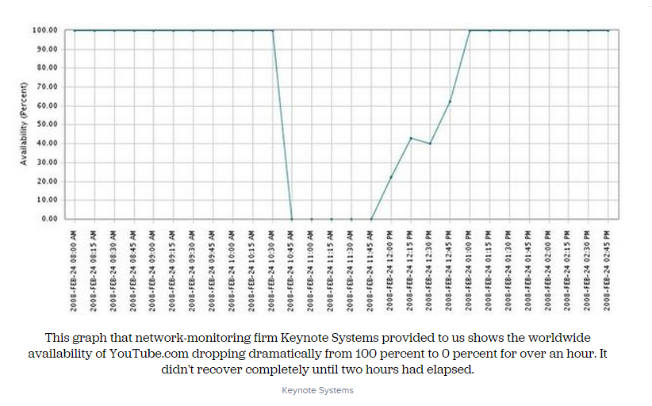
YouTube Availability
Source: http://www.cnet.com/news/how-pakistan-knocked-youtube-offline-and-how-to-make-sure-it-never-happens-again/

Slide 43
China Telecom Incident
China Telecom AS 23724 (a data center) normally originates 40 prefixes.
April 8, 2010, originated ~37,000 prefixes not assigned to them for 15 minutes.
About 10% of these prefixes propagated outside of the Chinese network.
Prefixes included cnn.com, dell.com, and many other Web sites.
Some traffic was diverted to China, passed through, and then went on to its destination!

Slide 44
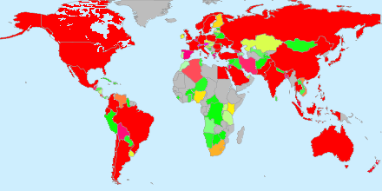
Impacted Prefixes
Source: http://www.bgpmon.net/chinese-isp-hijacked-10-of-the-internet/

Slide 45
Example Traceroute
1. <our host> | 0.785ms |  | # London
2. 195.66.248.229 | 1.752ms |  | # London
3. 195.66.225.54 | 1.371ms |  | # London
4. 202.97.52.101 | 399.707ms |  | # China Telecom
5. 202.97.60.6 | 408.006ms |  | # China Telecom
6. 202.97.53.121 | 432.204ms |  | # China Telecom
7. 4.71.114.101 | 323.690ms |  | # Level3
8. 4.68.18.254 | 357.566ms |  | # Level3
9. 4.69.134.221 | 481.273ms |  | # Level3
10. 4.69.132.14 | 506.159ms |  | # Level3
11. 4.69.132.78 | 463.024ms |  | # Level3
12. 4.71.170.78 | 449.416ms |  | # Level3
13. 66.174.98.66 | 456.970ms |  | # Verizon
14. 66.174.105.24 | 459.652ms |  | # Verizon
[.. four more Verizon hops ..]
19. 69.83.32.3 | 508.757ms |  | # Verizon
20. <last hop> | 516.006ms |  | # Verizon
Source: http://research.dyn.com/2010/11/chinas-18-minute-mystery/

Slide 46
Secure BGP
Still under development – generally not supported by routers yet.
Aims to prevent
  Bogus origin AS
  Bogus AS_PATH (unauthorized insertions and deletions of ASNs in the path)
All RIRs (Regional Internet Registries) now offer RPKI (Resource Public Key Infrastructure) services
… but no single root of trust, RIRs could (accidentally) conflict

Slide 47
Secure BGP – How will it work?
Route Origin Authorization (ROA) certificate authorizes AS to originate an advertisement for a prefix
Screening out unauthorized route originations doesn’t require changes to a router – preference for routes with ROA certificates can be installed by an external machine.
Each AS that adds its ASN to an AS PATH signs the resulting PATH before passing it on further.
Eventually, routers may choose not to accept unsigned advertisements.

Slide 48
Caveats
An AS may still choose not to route packets along the primary path that it advertises.
An AS can still eavesdrop on any traffic that passes through it.

